Slide 1
Mineta San Jose International Airport Capital Improvement Program Judy M. Ross, A.A.E – Assistant Director of Aviation
January 2019

Slide 2
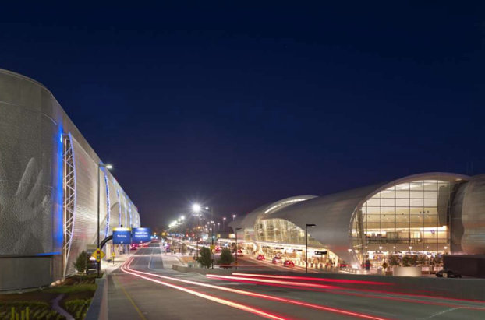
Norman Y. Mineta San Jose International Airport
Mission: To Connect, Serve and Inspire
Vision: To transform how Silicon Valley Travels
Owned and Operated by the City of San Jose
1,000 acre site with two parallel runways
Serving commercial and general aviation
52 Non-Stop Routes
210 Peak Daily Departures
9 Domestic and 6 International Carriers
Reached 12.3 Million Annual Passengers in Dec 2018

Slide 3
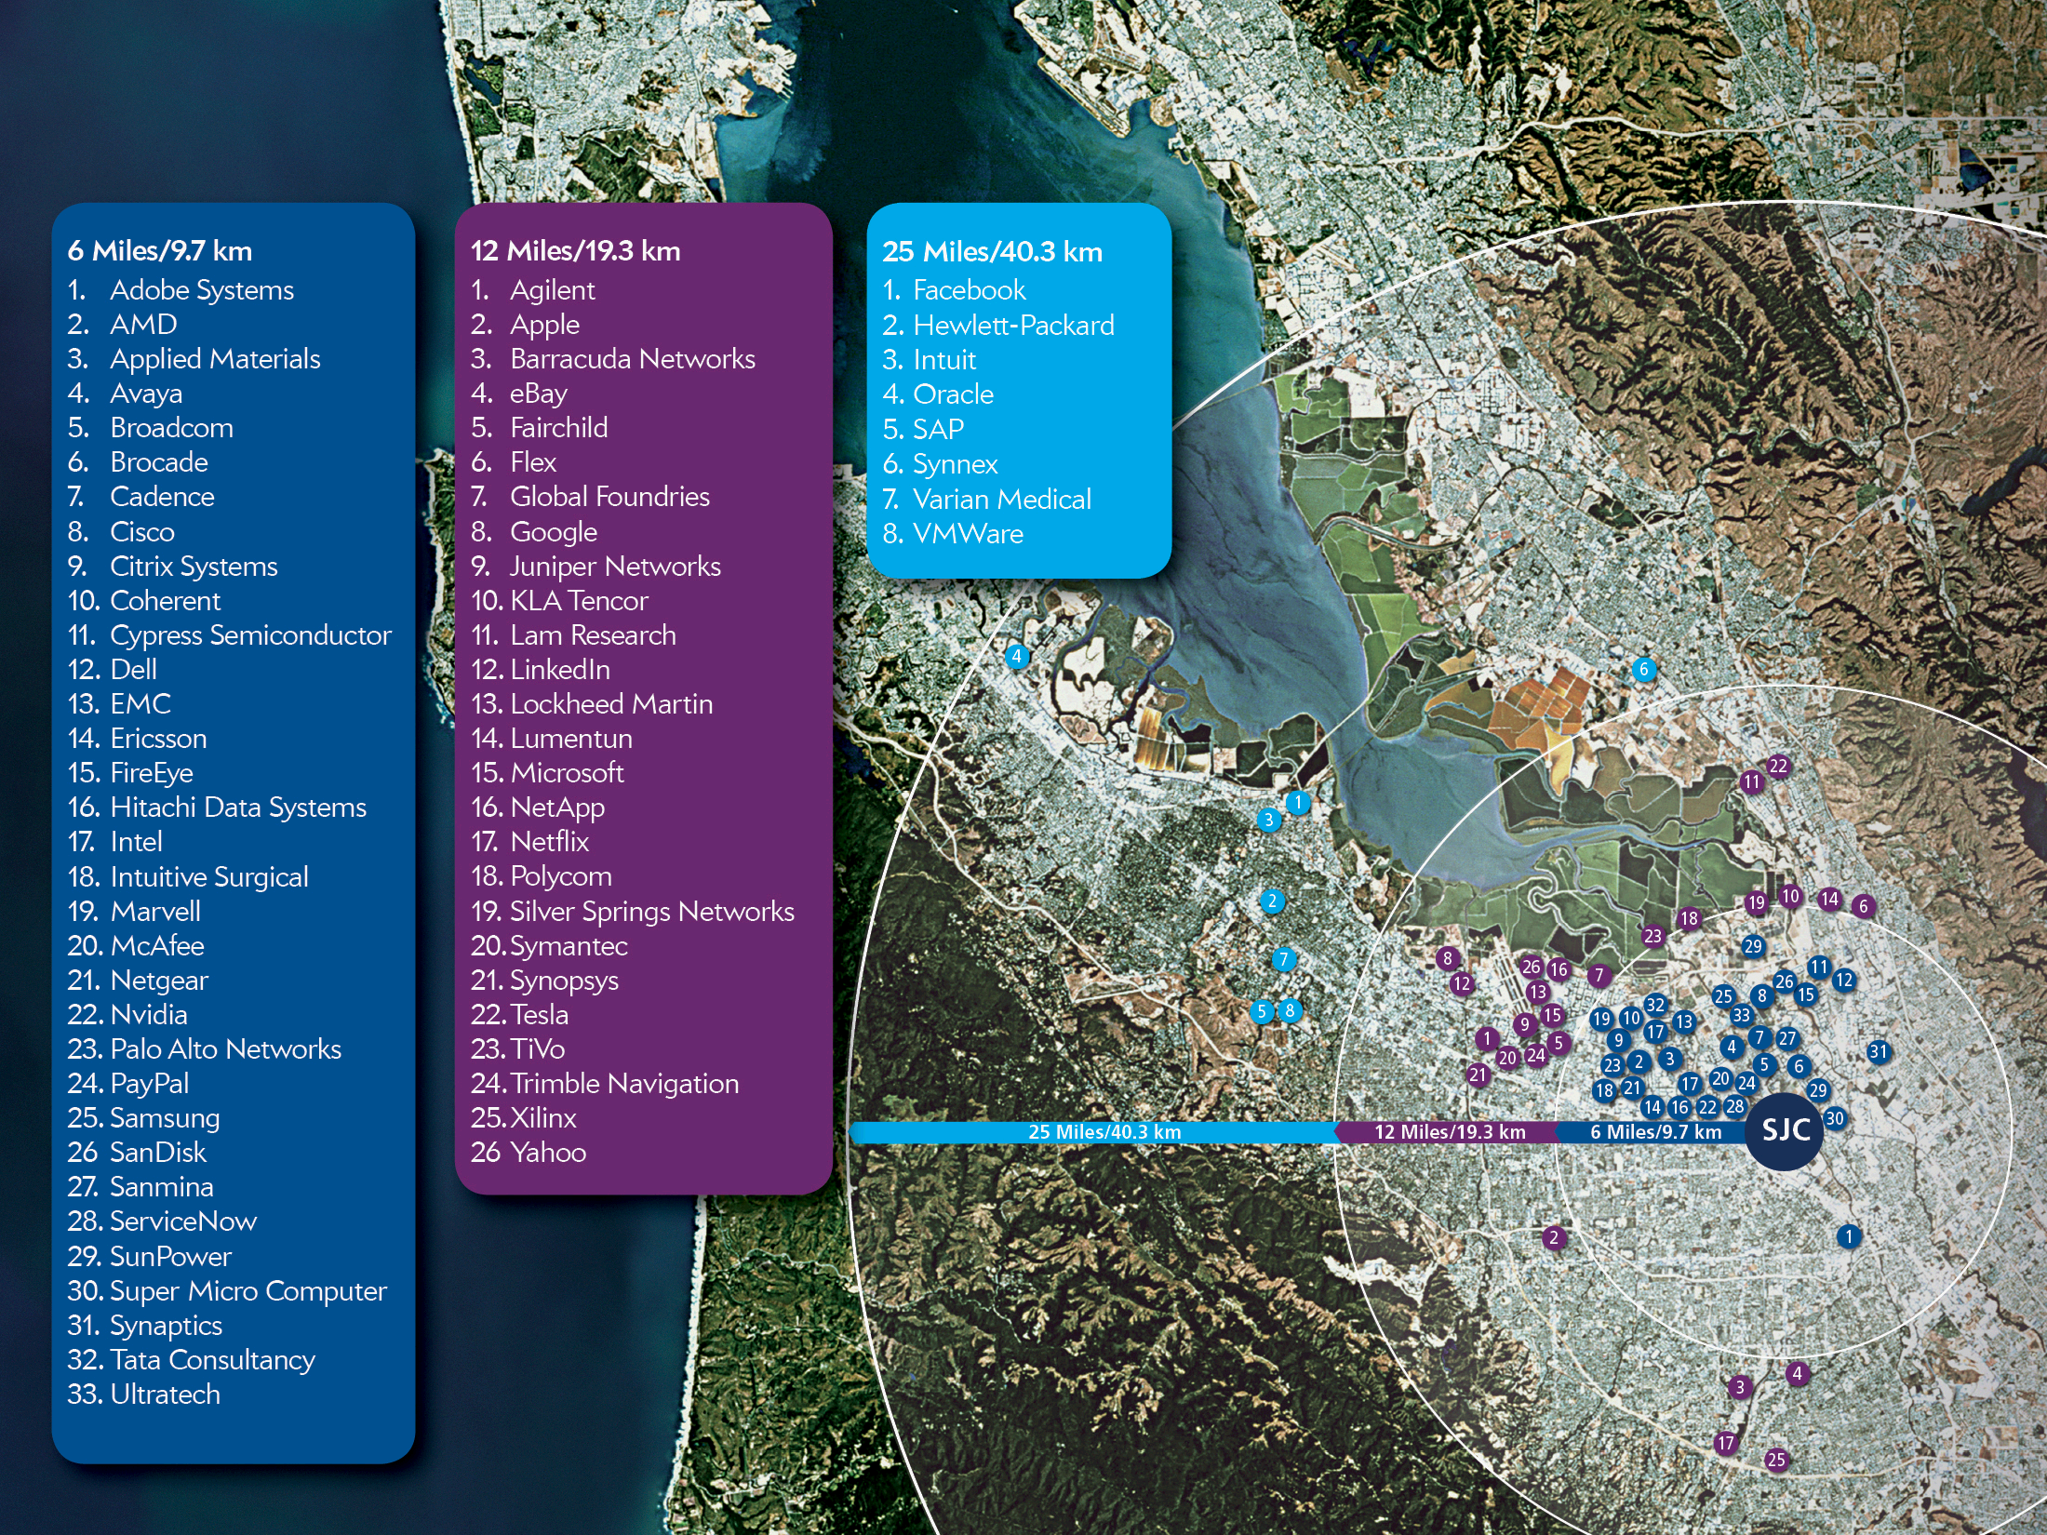
SJC is Uniquely Located to Serve Silicon Valley

Slide 4
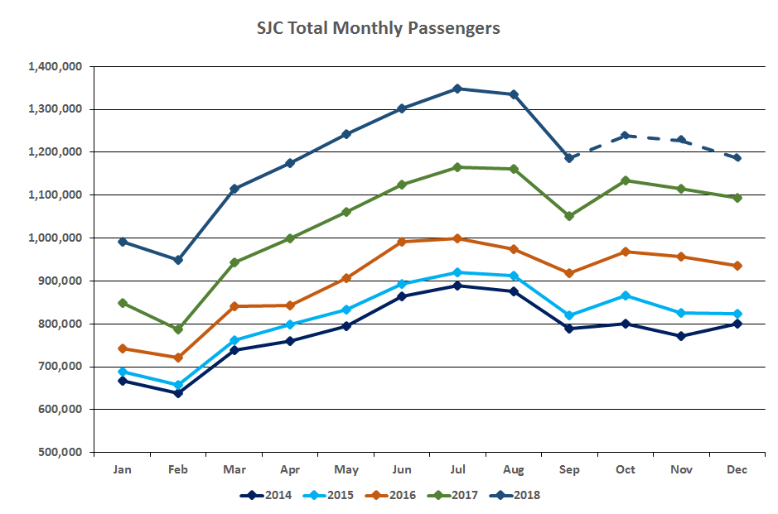
SJC Total Monthly Passenger Trends
14.3 Mil
12.5 Mil
10.8 Mil
9.8 Mil
9.4 Mil
8.8 Mil (YE 2013)
Notes:
2015 – Growth at 4.4%
2016 – Growth at 10.2%
2017 – Growth at 15.6%
2018 – Growth at 17.2%
June 2018, We became second busiest in the Bay Area

Slide 5
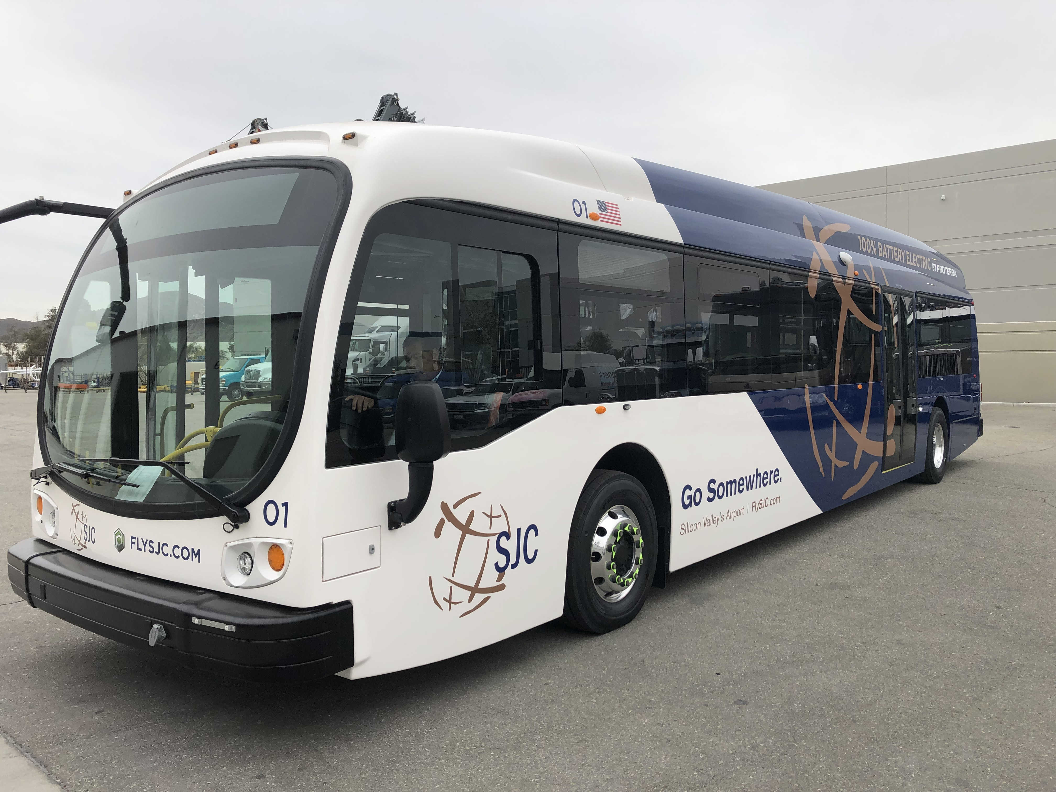
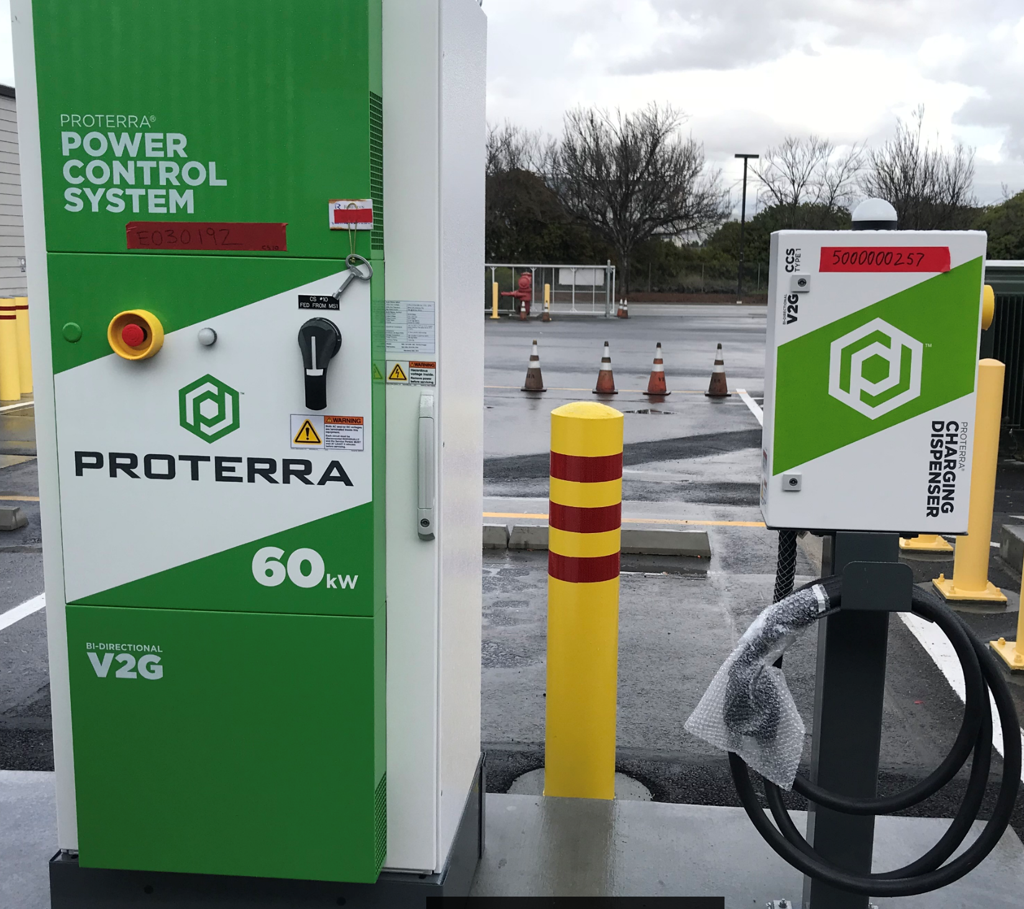
Current Major Capital Projects
Zero Emission Buses
Purchase ten of zero emission electric buses and chargers;
Installation of infrastructure (transformers, duct banks, conduit, and cable) and accessories (hand holes, distribution panels and control) for the electric bus charging stations;
Target Completion Date: March 2019

Slide 6
Current Major Capital Projects
Airfield Electrical Rehabilitation – Phase 1
Rehabilitation and replacement of airfield lighting circuit cables, lighting, transformers for both runways
Consolidation of circuits and new constant current regulators
Conversion of existing incandescent lights to LED technology
Target Completion Date: 11/2019

Slide 7
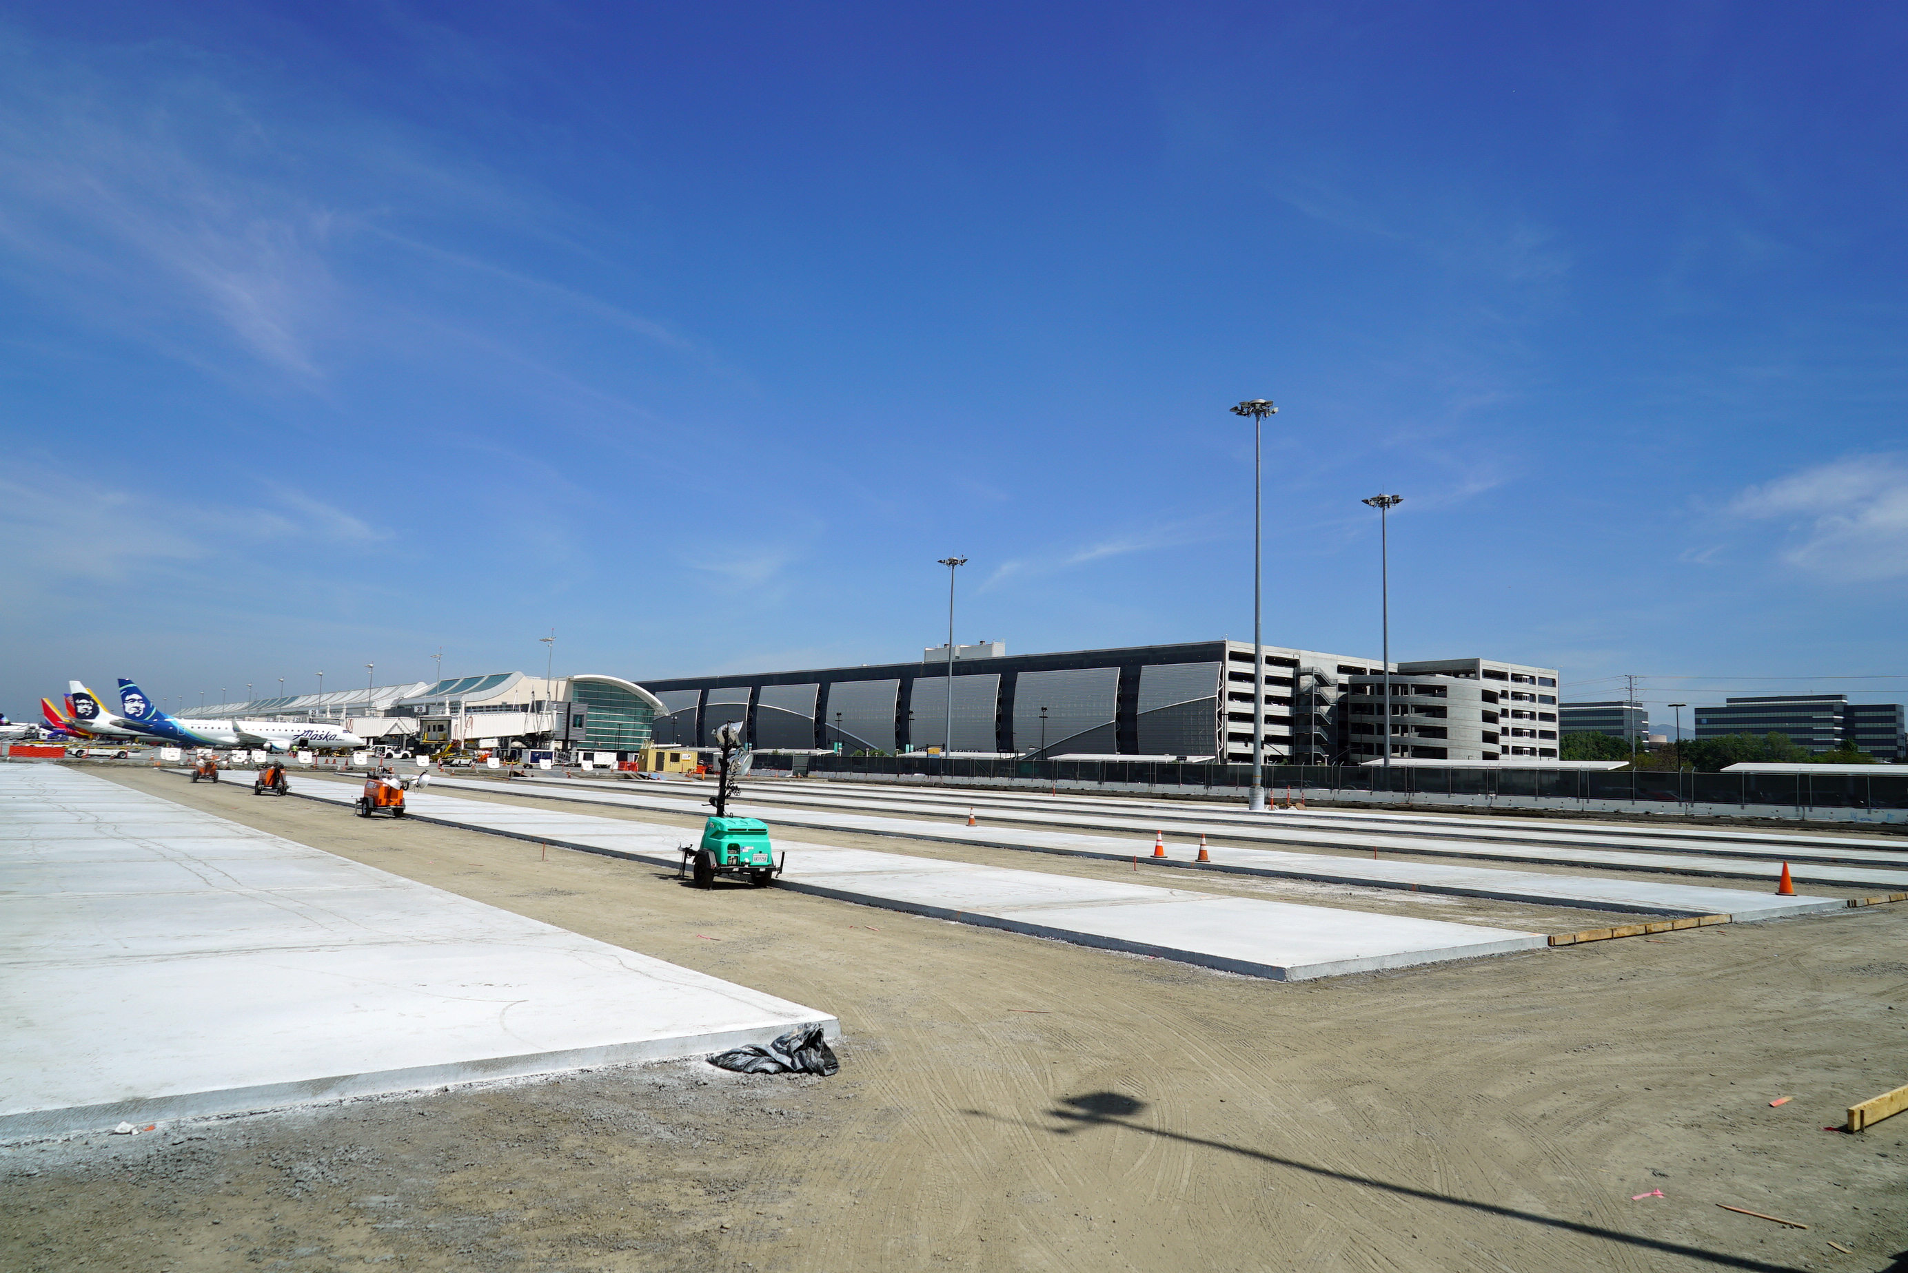
Current Major Capital Projects
Terminal B Apron Rehabilitation – Phase 2 & 3
Removal and replacement of approximately 118,000 sq ft
Project will allow new apron for Interim Facility
Target Completion Date: 05/2019

Slide 8
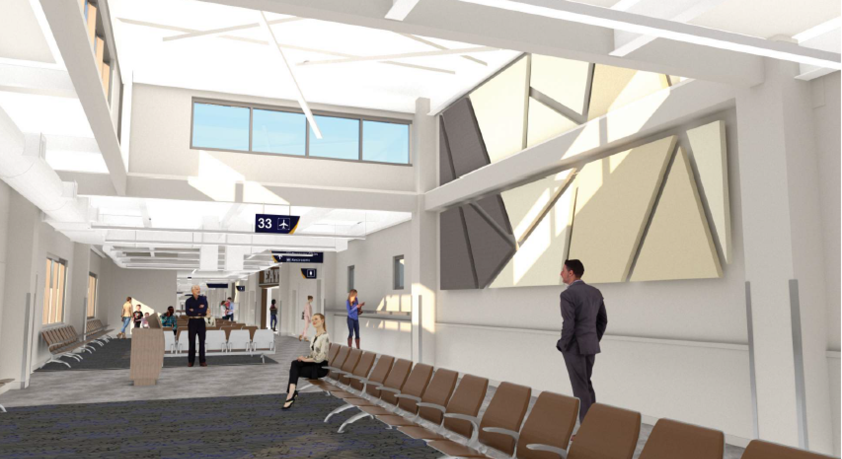
Current Major Capital Projects
Six Gates Interim Facility
An enclosed walkway
A ground-level covered arrivals walkway
Single-story hold room of about 15,000 square feet in size
Six aircraft parking positions
Target Completion Date: 06/2019

Slide 9
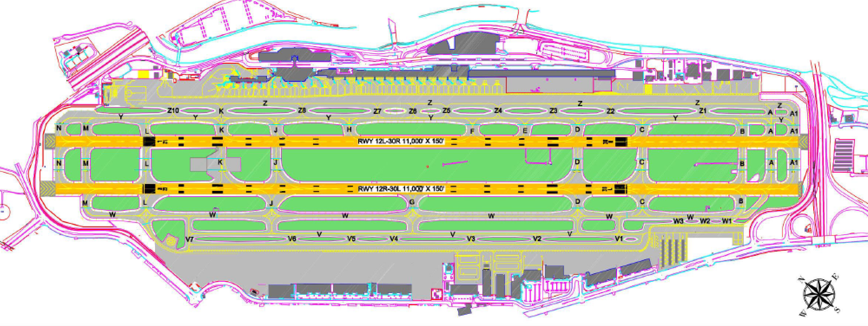
Upcoming Major Construction Opportunities
Airfield Geometric Implementation
Runway/Taxiway/Ramp realignment
Conversion of existing runway 11-29 to a taxiway
Construction of new taxiway connectors
Relocate general aviation run-up pads
Realign existing cross taxiways
Extension/widening of existing taxiways

Slide 10
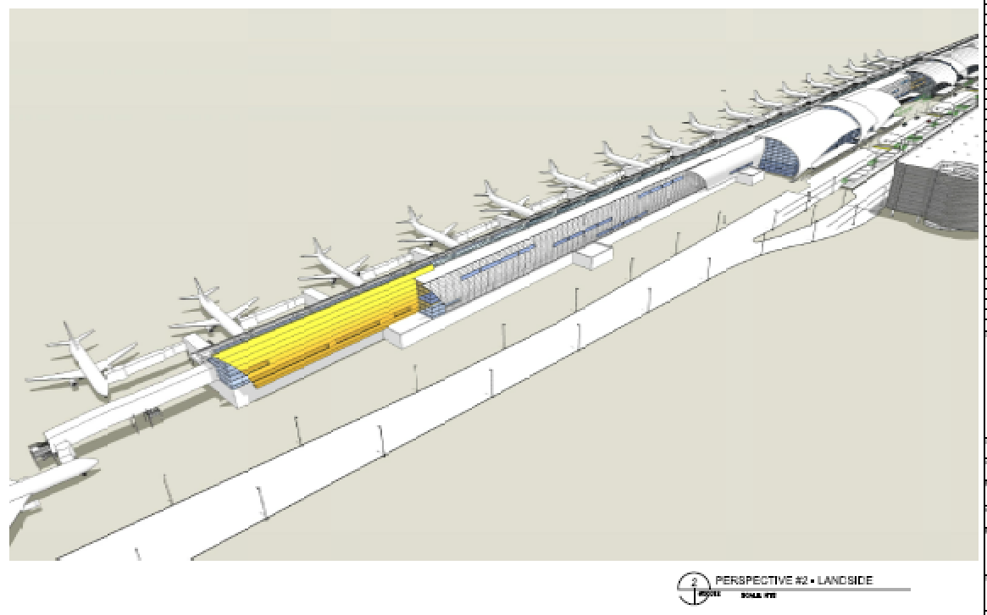
SJC Airport Master Plan
Initially Adopted by the City of San Jose in June 1997
Updating the Airport Master Plan
Notice of Preparation comments due January 31, 2019
Specific improvement projects including:
Implementation of Airfield Geometric Improvements
Expand Terminal B
Lot 1 Long Term Parking Garage
Public short-term parking garage
Multi-story business hotel
New cargo airline facilities

Slide 11
Questions

